Slide 1
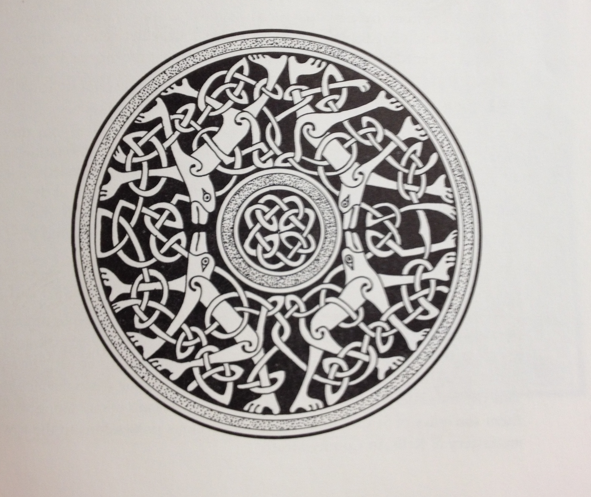
Untangling Celtic Knots
Imogen Isabella Morris
4th October 2015

Slide 2
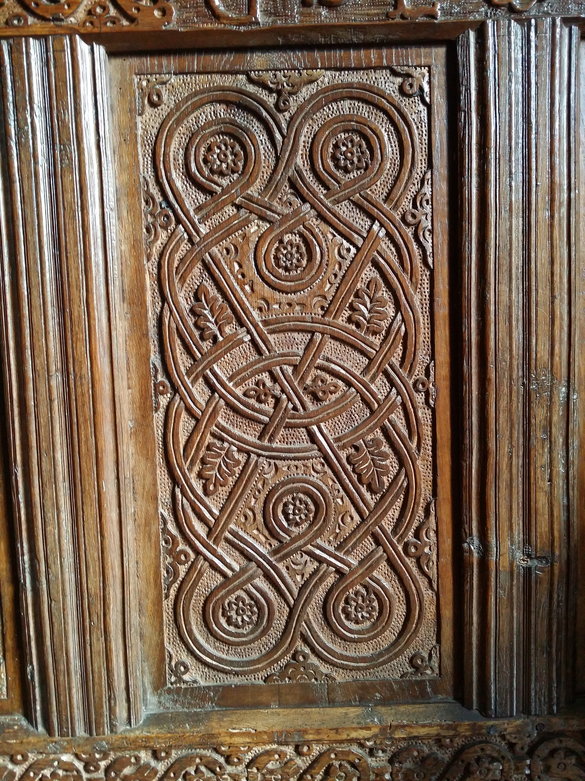
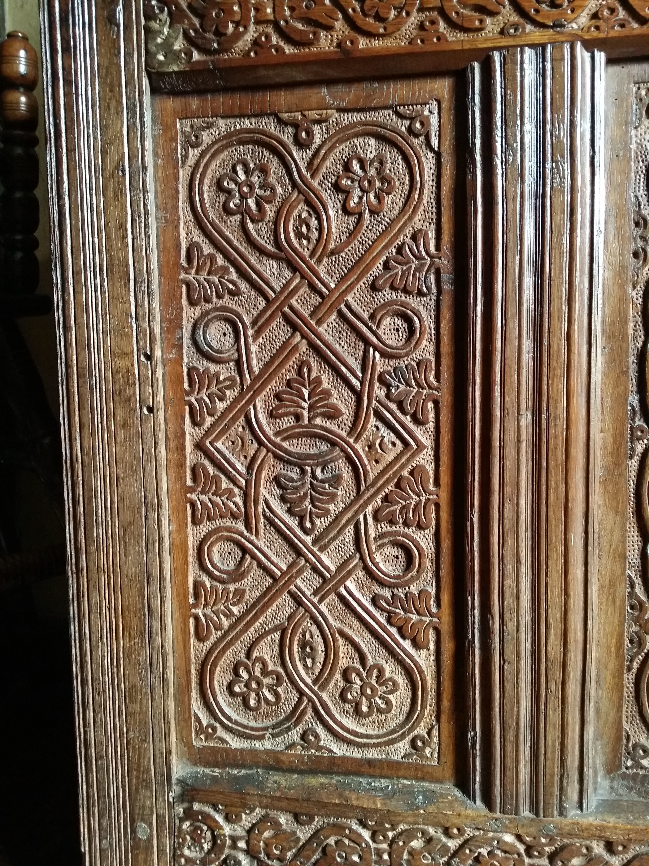
Celtic knots at Townsend, Lake District

Slide 3
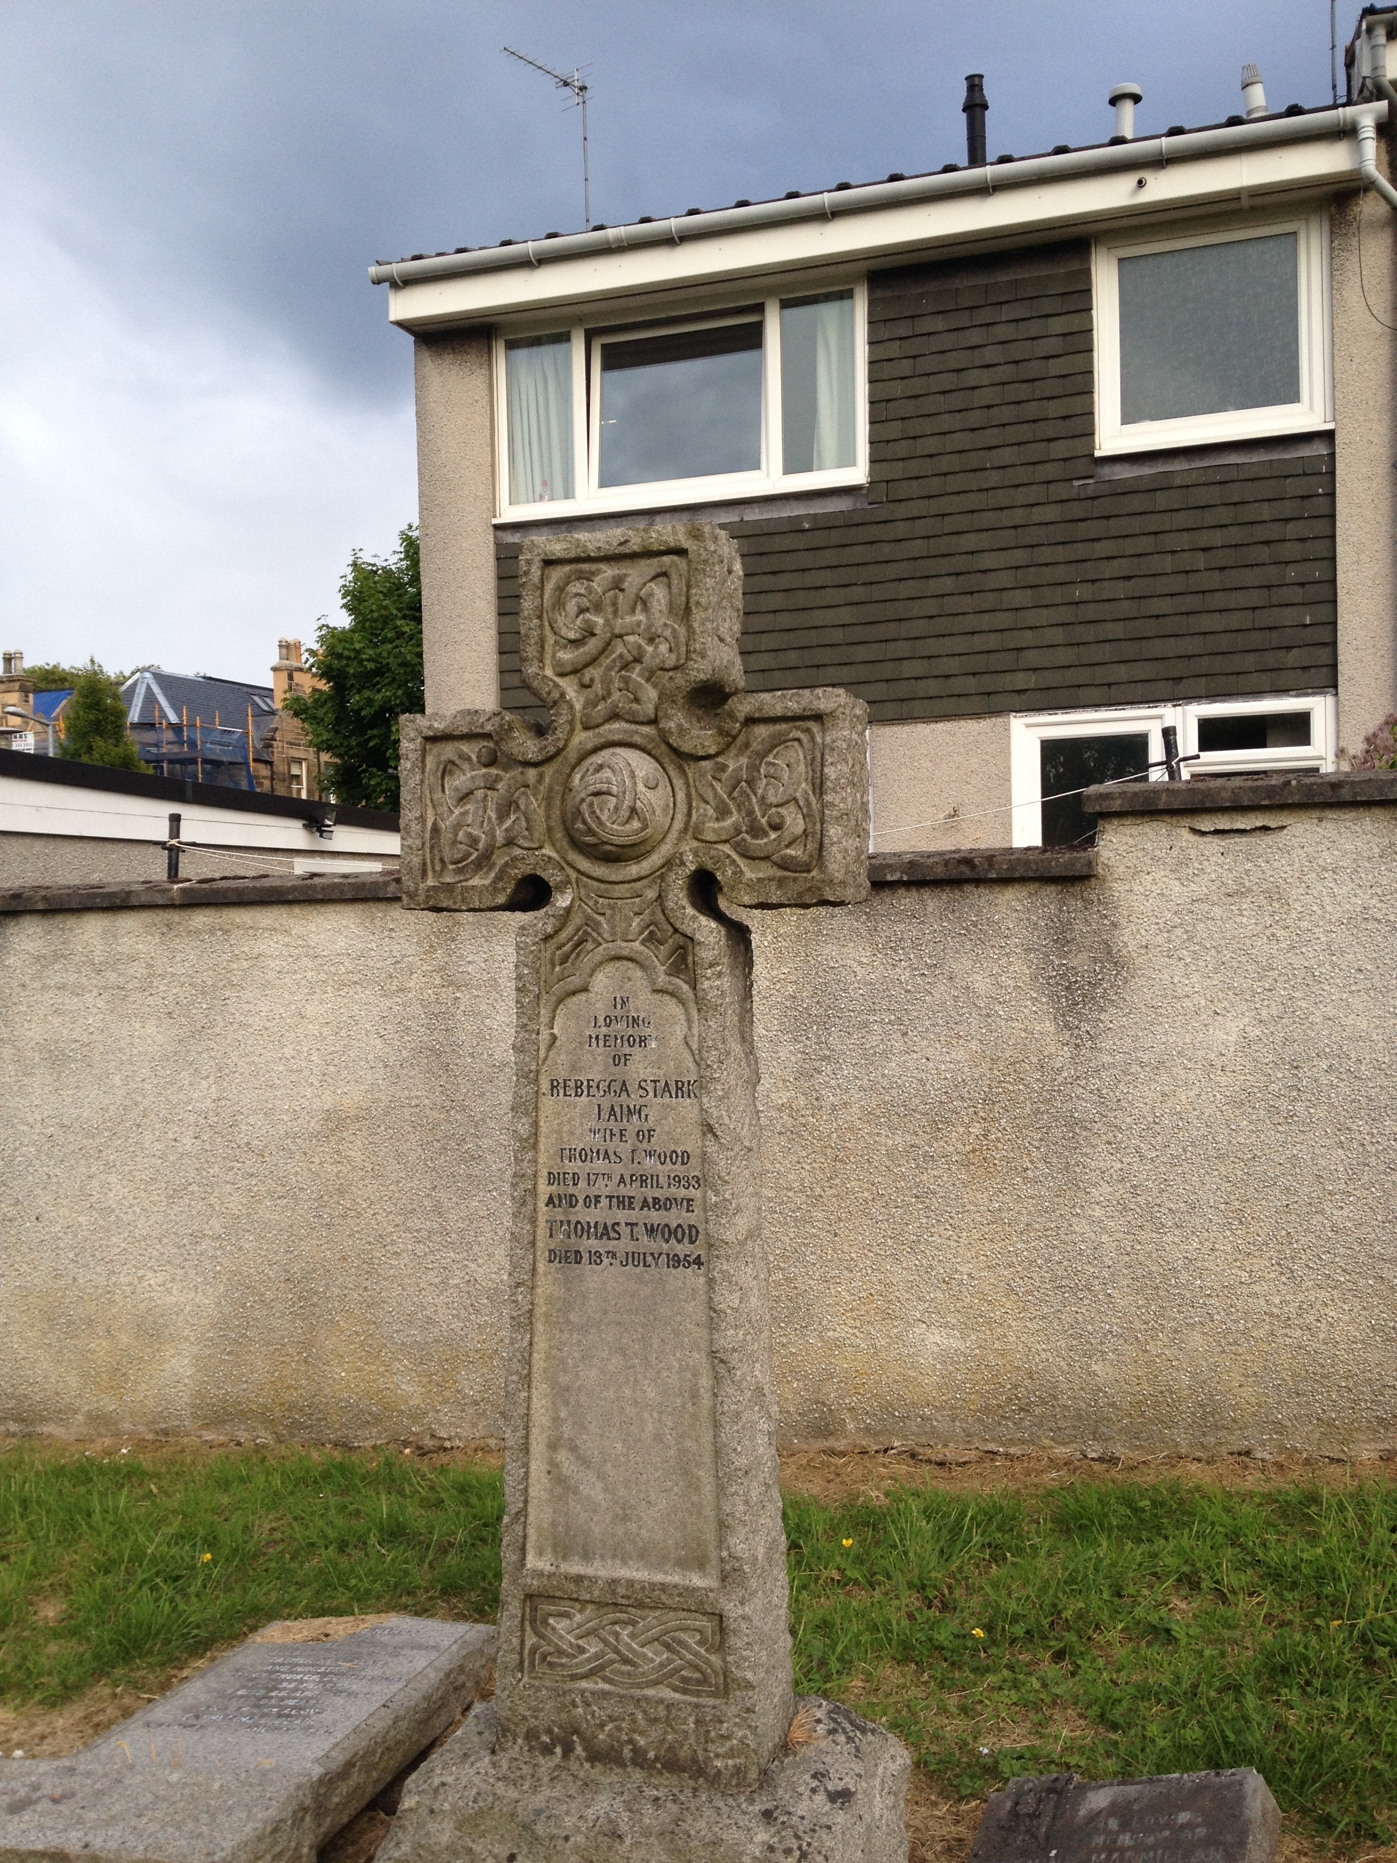
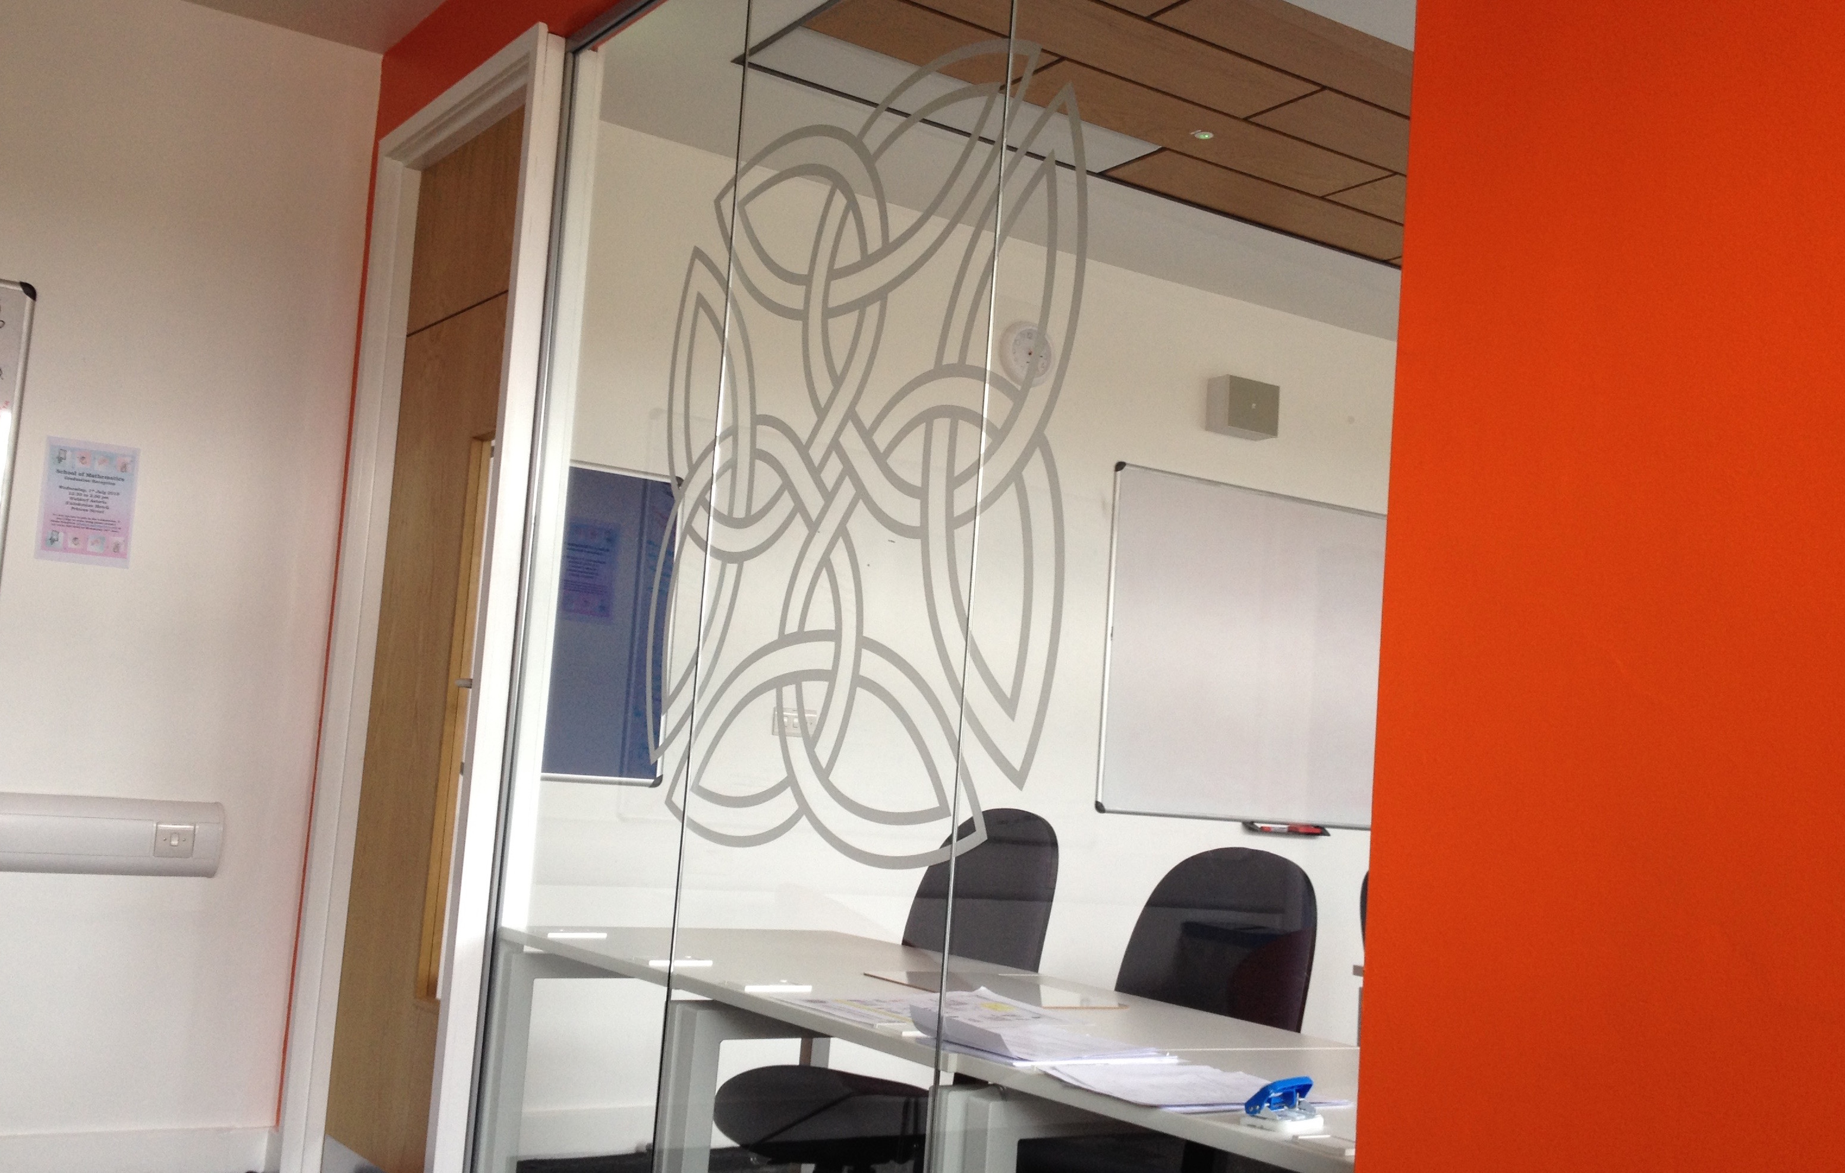
Celtic Knots in Edinburgh

Slide 4
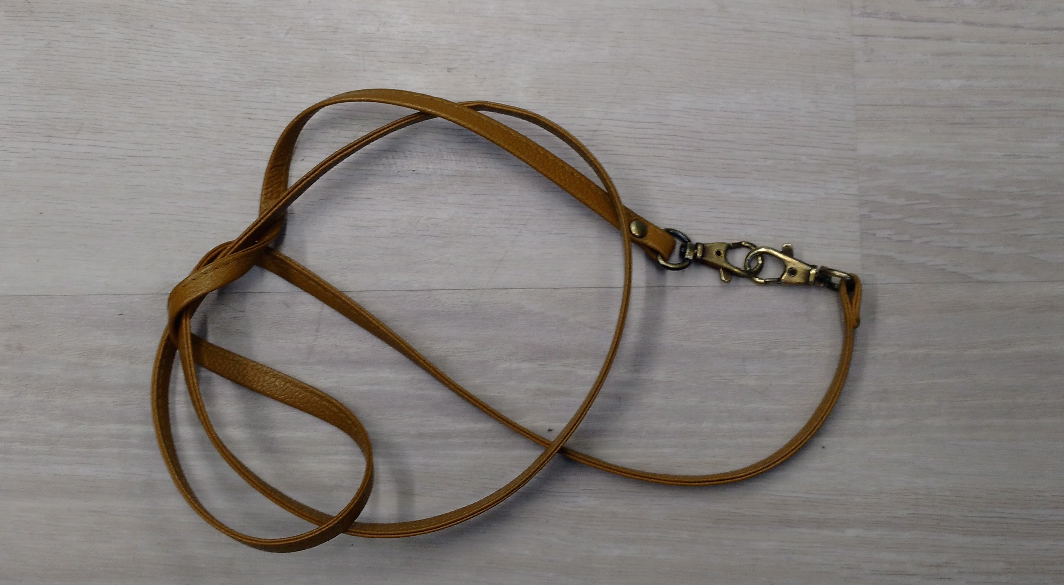
Mathematical knots (and links)

Slide 5
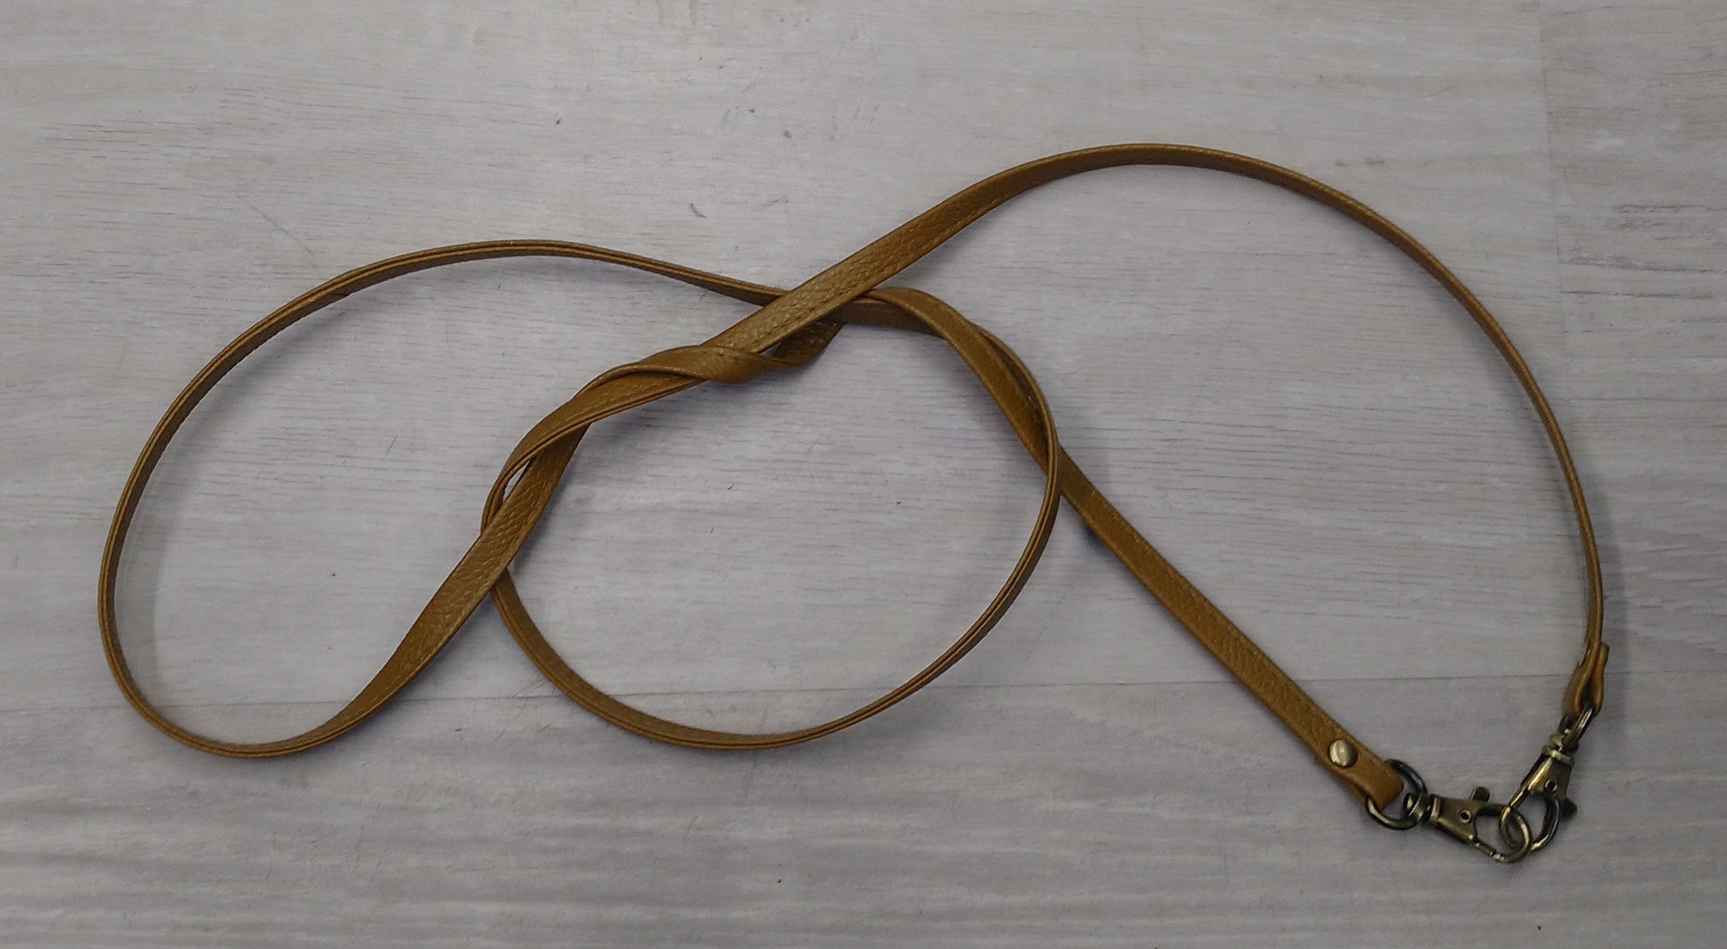

Slide 6
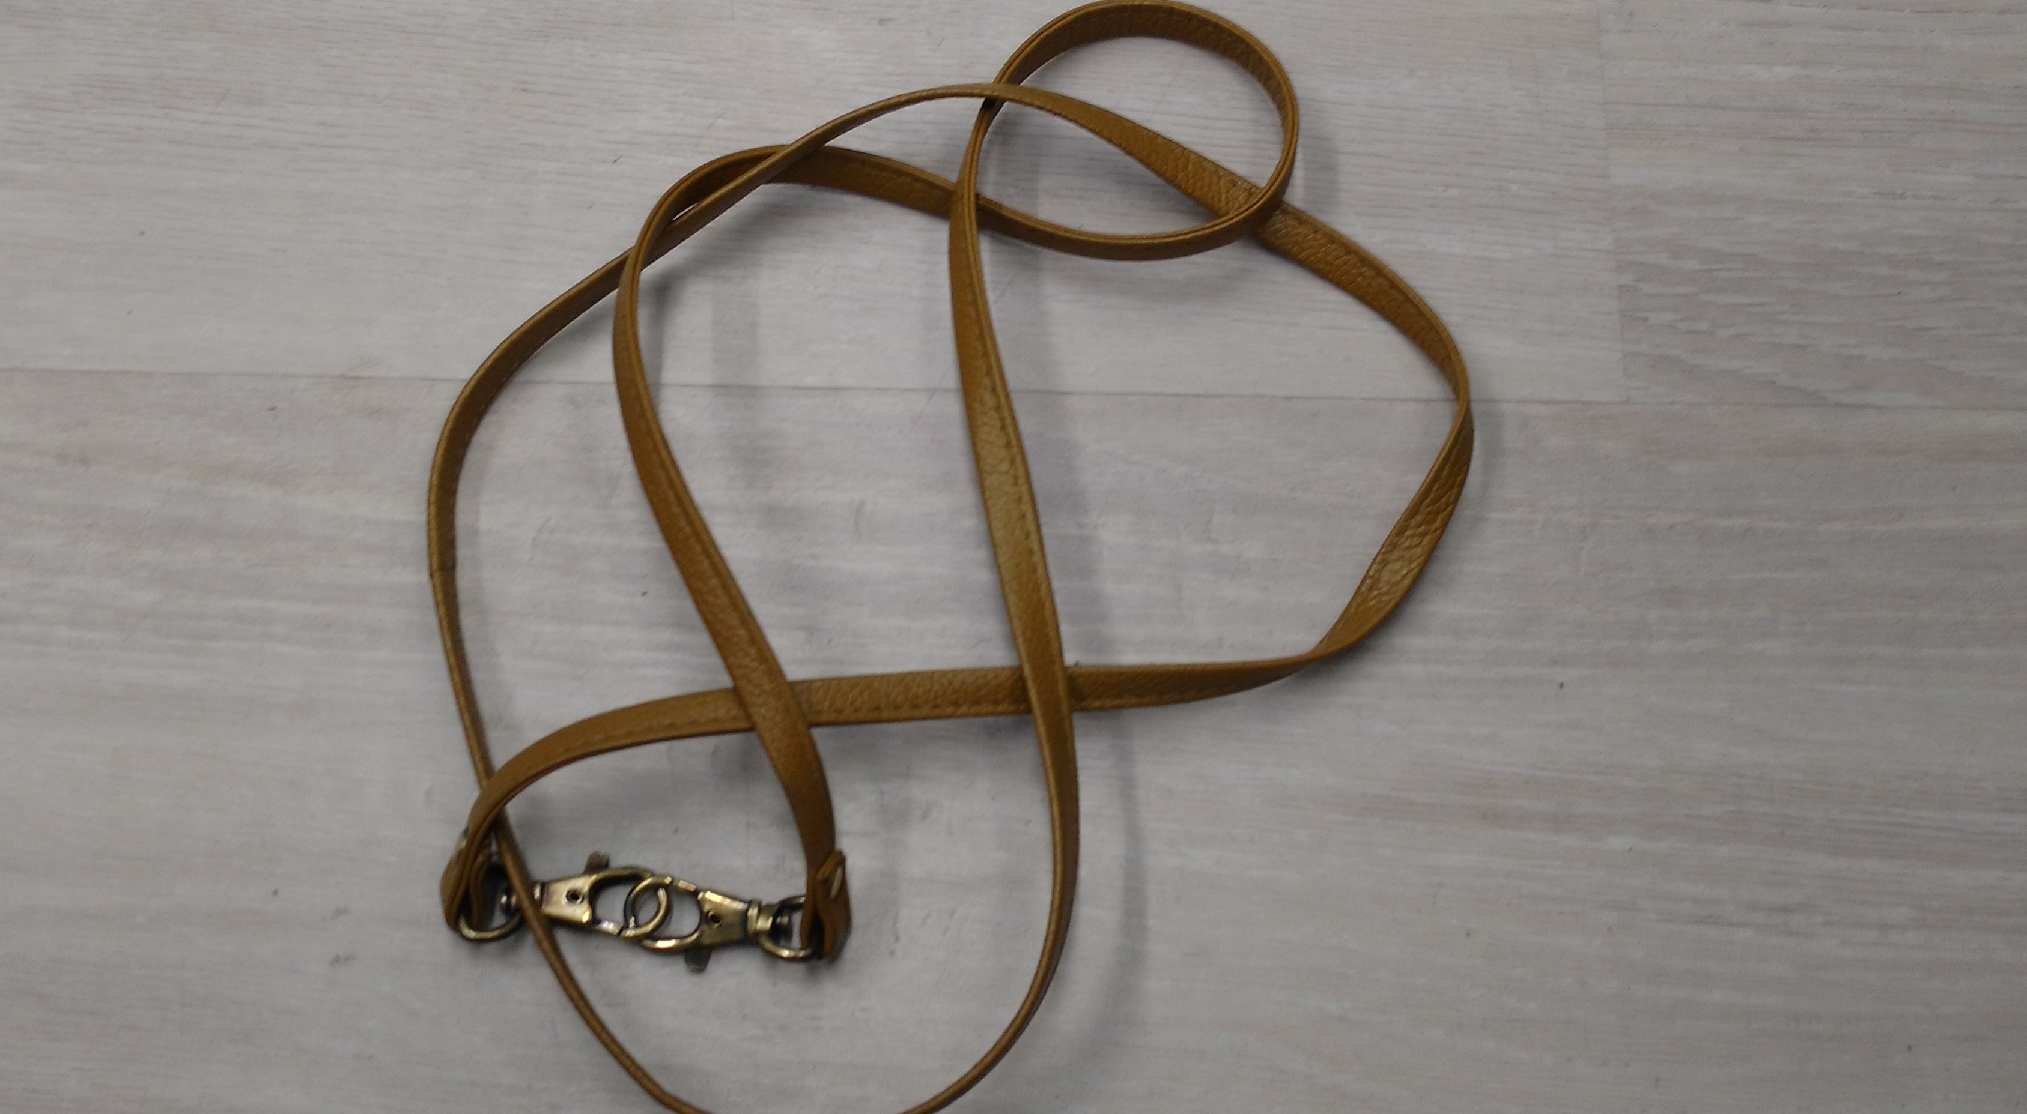

Slide 7
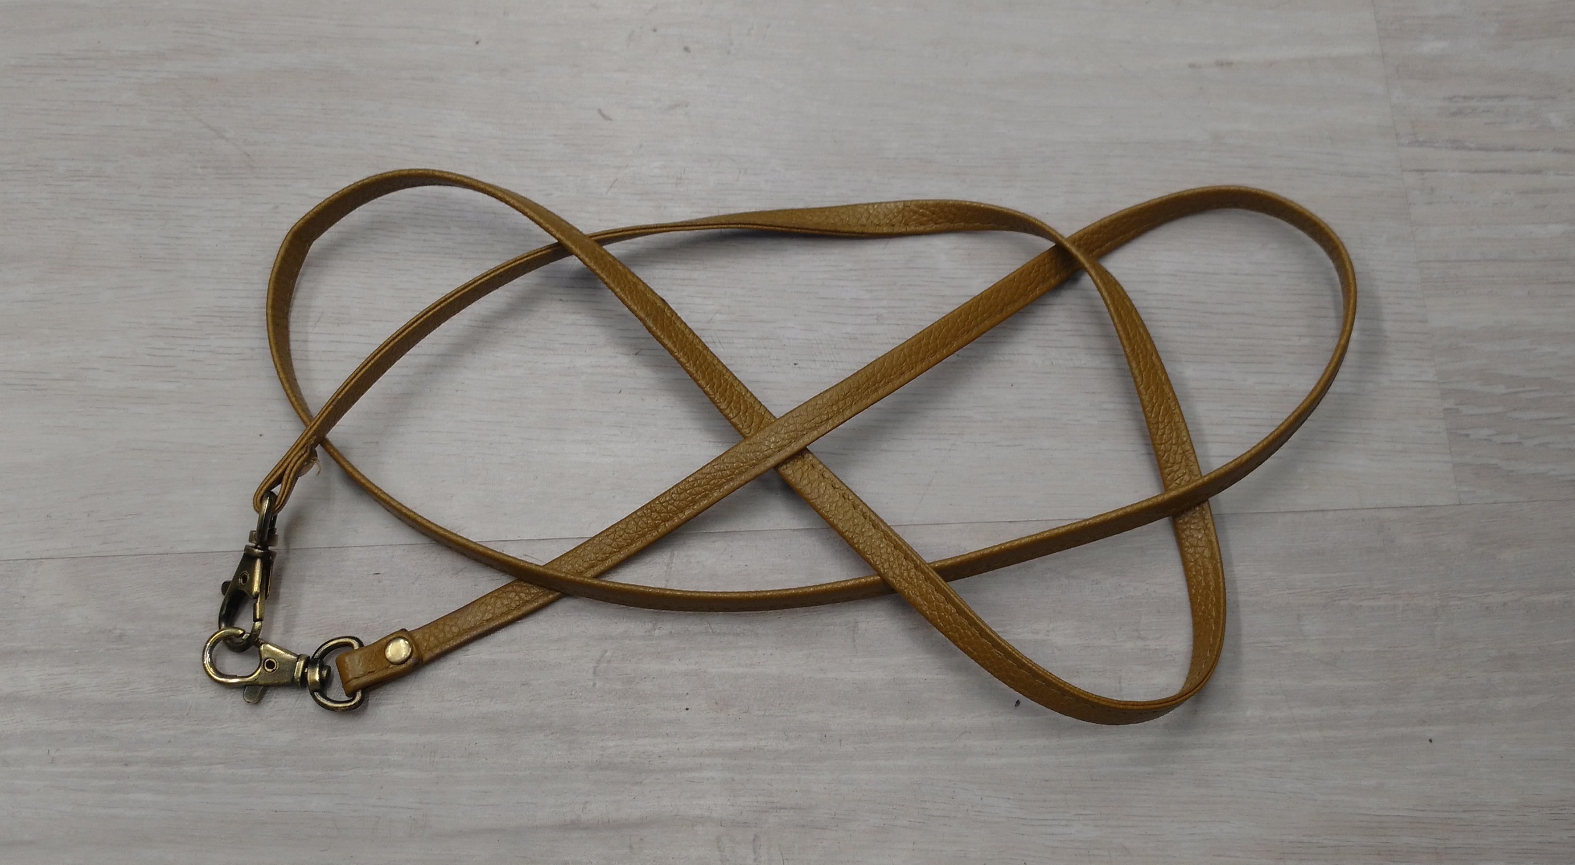

Slide 8
Definition of a Celtic Plait
Subset of Celtic knots
Can be drawn on a grid
Alternating
Matlab program

Slide 9
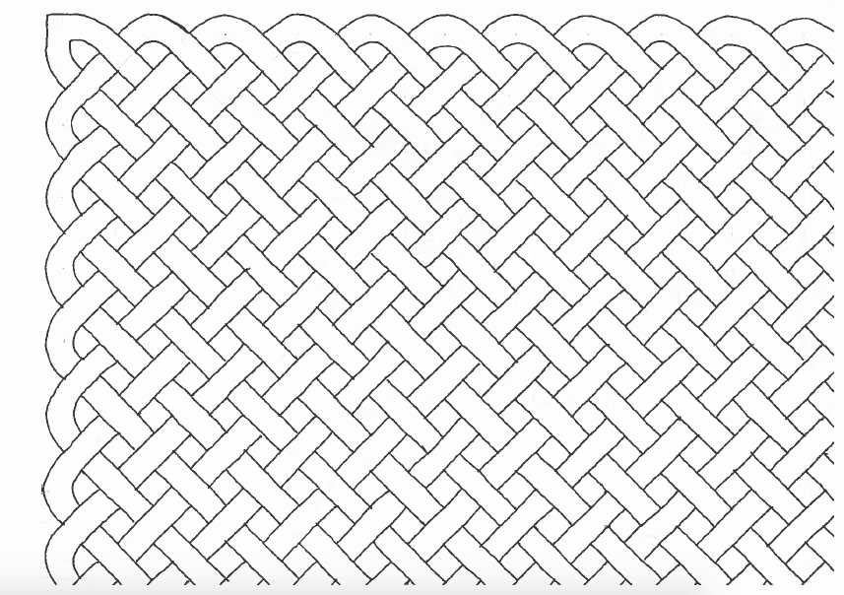
Celtic Plait

Slide 10
How do we recognise Celtic plaits?
Alexander polynomial
Seifert matrix

Slide 11
Seifert Surface
Seifert’s algorithm
Bands (demonstration)
Orientable surface
Seifert view (created by Jarke J. van Wijk, Technische Universiteit Eindhoven)

Slide 12
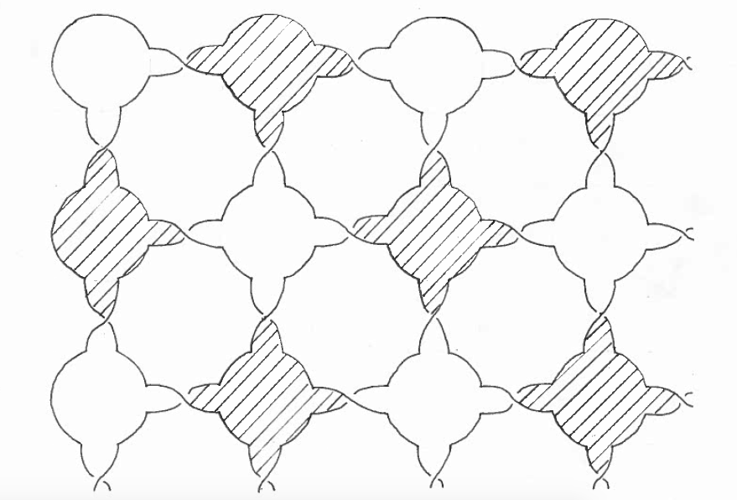
Seifert Surface of Celtic Plaits

Slide 13
Seifert Matrix
Closed curves
Linking numbers

Slide 14
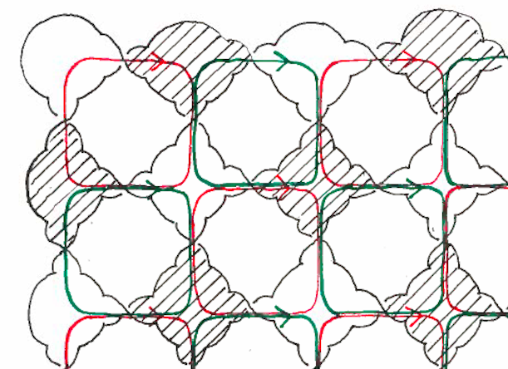
Closed Curves

Slide 15
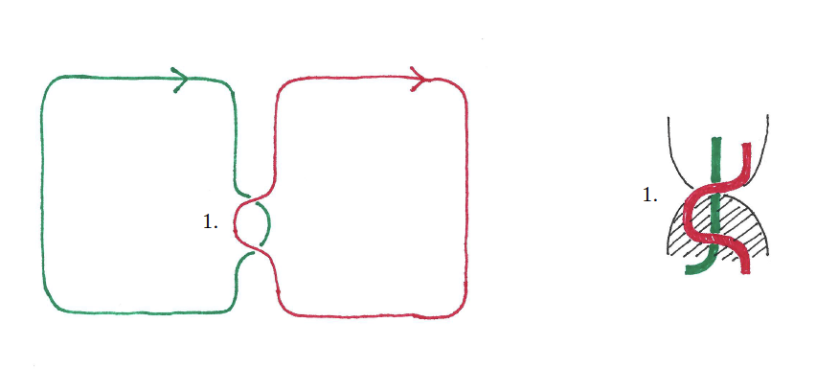
Linking Numbers (1)

Slide 16
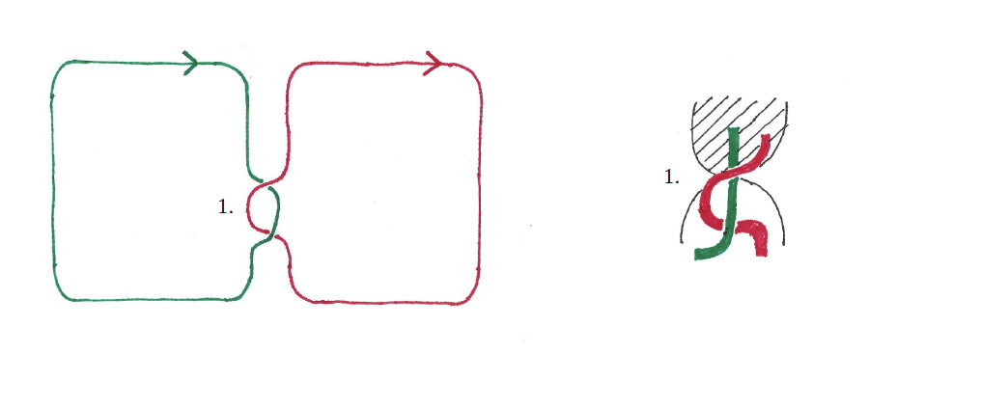
Linking Numbers (2)

Slide 17
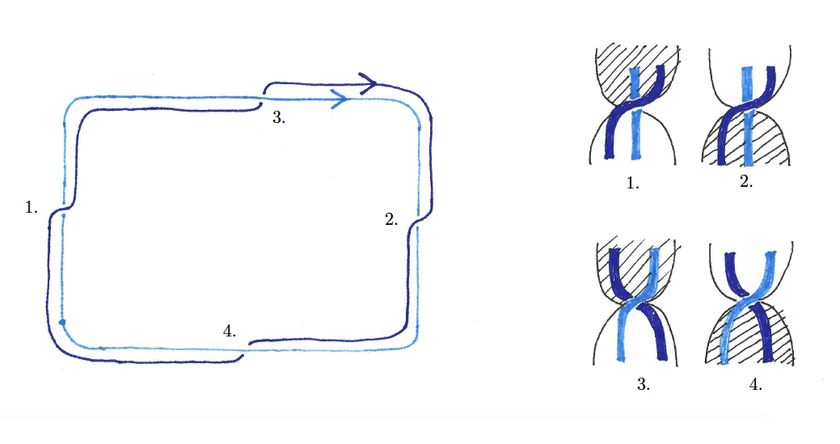
Linking Numbers (3)

Slide 18
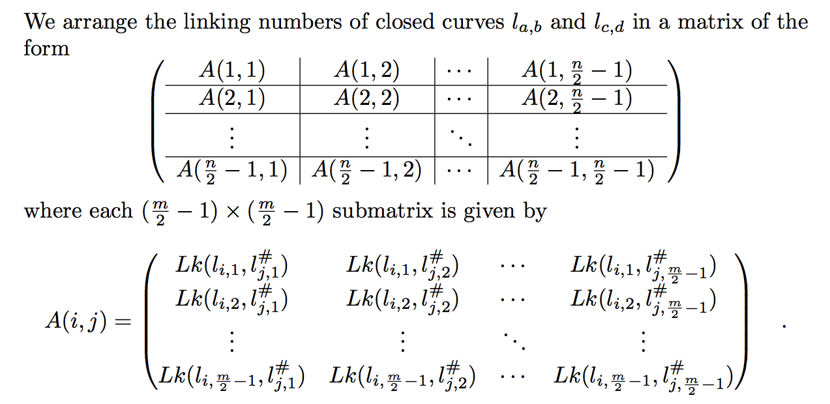
Seifert Matrix

Slide 19
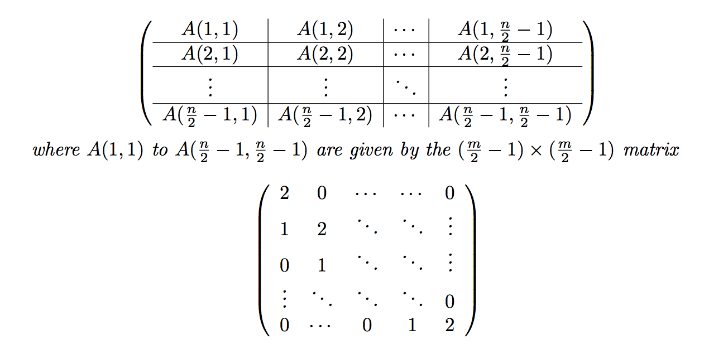
Seifert Matrix

Slide 20
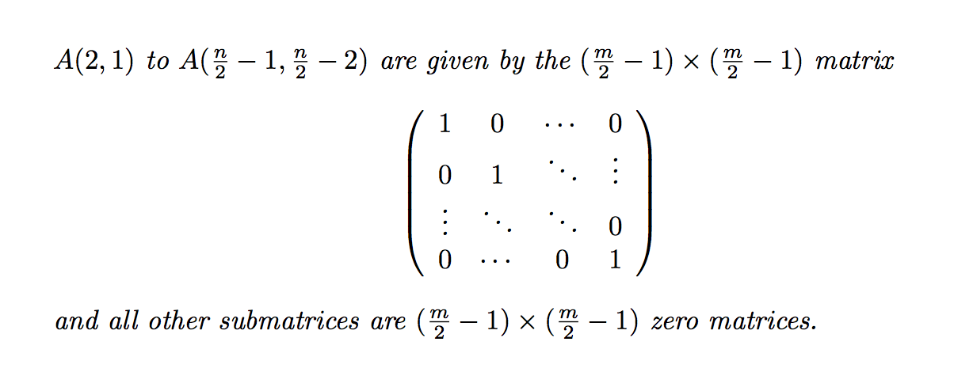
Seifert Matrix

Slide 21
Alexander Polynomial
Alexander Polynomial from Seifert Matrix
Alexander Polynomial of 7 4 knot.

